Slide 1
Image registration using convolution neural network
-Chidambar kulkarni

Slide 2
INTRODUCTION
Image registration is a fundamental task in computer vision and medical imaging that involves aligning multiple images of the same scene or object taken from different viewpoints, angles, or at different times. The goal of image registration is to find a transformation that brings the images into a common coordinate system, allowing for comparison, analysis, and fusion of the information contained in these images.

Slide 3
TRADITION IMAGE REGISTRSTION TECHNIQUES
Traditional image registration techniques employ various approaches to align images. Here's an overview of some commonly used methods:
Feature-Based Methods:
These methods identify and match distinctive features (such as corners, edges) between images.
Feature extraction algorithms (eg: SIFT) are used to detect and describe features.

Slide 4
Intensity-Based Methods:
These methods directly compare the intensity values of corresponding pixels or voxels in the images.
Measures of similarity, such as sum of squared differences (SSD) or normalized cross-correlation (NCC), are computed to evaluate the alignment quality.
Landmark-Based Methods:
These methods rely on manually or automatically placed landmarks (e.g., anatomical landmarks) in the images.
Correspondences between landmarks are established, and the transformation is estimated using techniques like thin-plate spline or affine transformations.

Slide 5
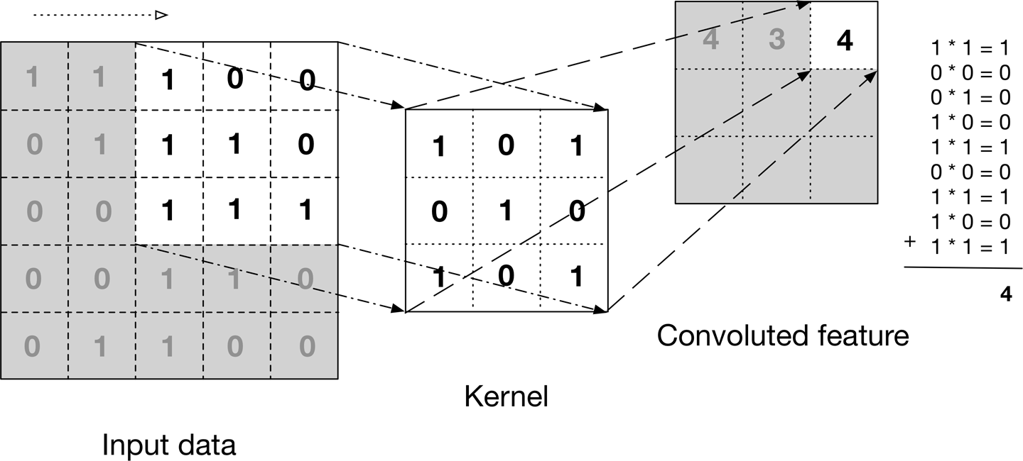
CNN ARCHITECTURE FOR IMAGE REGISTRATION
Convolutional Layers: By convolutional zing learnable filters with the input image, these layers extract features by identifying local patterns and spatial correlations.

Slide 6
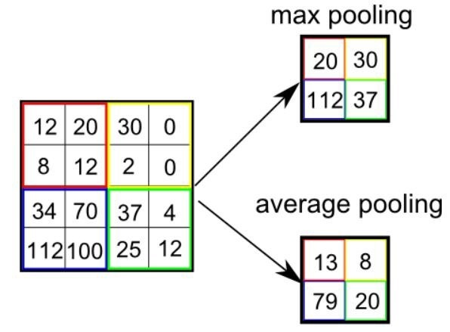
Pooling Layers: Pooling techniques, such as maximum pooling or average pooling, minimum pooling, lower the spatial dimensionality of the features, strengthening translational invariance and making the network more resilient to changes in input image size.

Slide 7
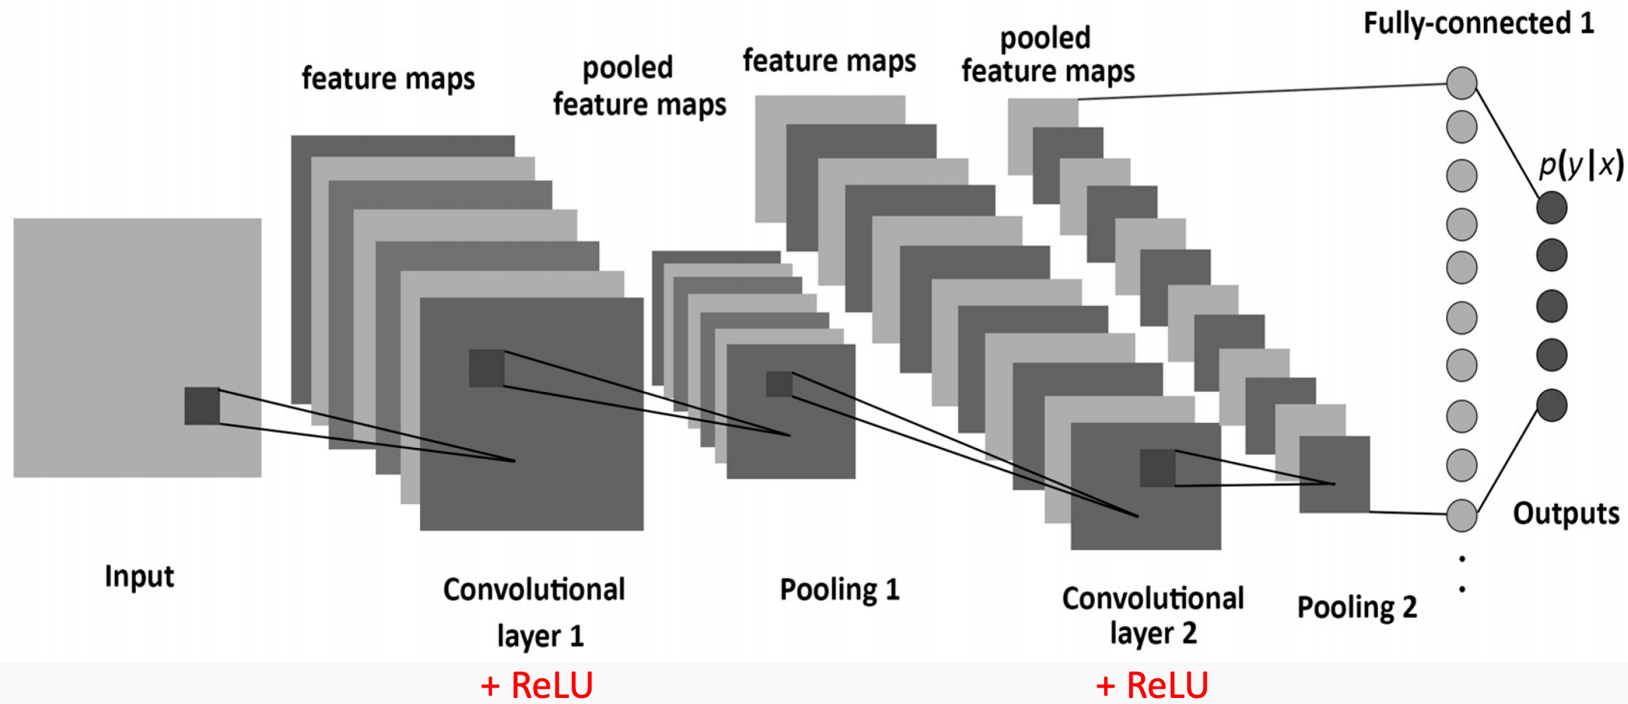
Fully Connected Layers: These layers process the convolutional layer's retrieved features and convert them to the required output, such as displacement fields or transformation parameters

Slide 8
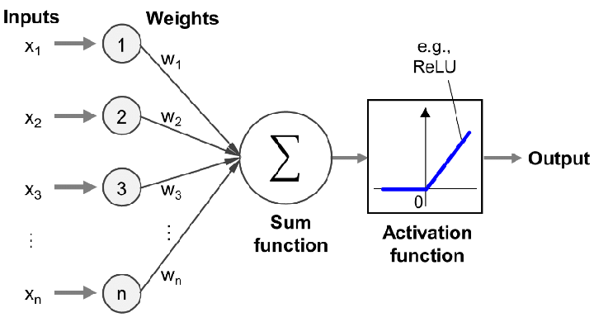
REL (Rectified Linear Unit) and sigmoid are two non-linear activation functions that provide non-linearity to the network and allow for the modelling of intricate interactions between features.

Slide 9
APPLICATION OF CNN
Medical Imaging: CNNs have revolutionized medical imaging analysis. They are used for tasks like disease diagnosis, tumor detection, and medical image segmentation
Natural Language Processing: CNNs are not limited to image-related tasks; they are also employed in natural language processing. CNNs are used for text classification, sentiment analysis, text generation, and language translation tasks.
Video Analysis: CNNs are used in video analysis tasks, including action recognition, video classification, and video object tracking.
These are just a few examples of the many applications where CNNs have demonstrated their effectiveness. The ability of CNNs to learn hierarchical representations from input data have made them a powerful tool in various fields of computer vision, pattern recognition, and artificial intelligence.

Slide 10


